Slide 1
Sun City Computer Club
Securing a Home Network
August 16, 2018

Slide 2
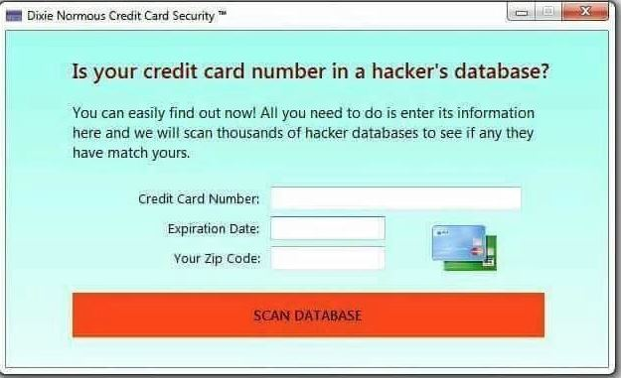

Slide 3
Vocabulary
Safer not Safe
E-postcard not e-mail
ADMINISTRATOR
Passphrases not passwords
Radio not wireless

Slide 4
Chicken Little
Tortoise and hare
Each of us safer, all of us safer
Age does NOT diminish cognitive ability
Life, Liberty, Pursuit of Happiness
Cyber Security SIG
Cyber Security Blog
Internet
Do nothing no problem
<most of us>
Do everything - catastrophic

Slide 5
What does John know
First job computing 1962
9 years semi-conductor manufacturer
30 years Cyber engineer Major Oil Co.
Very early WEB experience
3 years Alyeska Pipeline DHS
Major Cyber Security Certifications
Network of cyber professionals
Computer Club presentations
Cyber Security SIG
Windows SIG
Senior University

Slide 6
Biggest cyber security threat
you

Slide 7
Best cyber security defense
you

Slide 8
The chase
Use cellular
Wi-Fi & Bluetooth off unless required
Use Linux
bootable CD/DVD write protected USB
Virtual machine
tethered to Cellular hotspot
Old devices
smart phone for IoT command & control
old laptop/desktop for Linux
Hard wire ethernet connection
Unplugged when not in use

Slide 9
Multiple
Identity
Machines
Browsers
Security suites
HOME NETWORKS
segmentation
VLANs Guest wireless
email addresses
Phone numbers

Slide 10
How Internet gets into your home
Dial-up modem
Digital Subscriber Line DSL
Satellite down link
Wi-Fi metro mesh
Fixed Wireless
Cellular
Cable modem

Slide 11
The Internet is vital
The Internet is vulnerable
DNS, BGP, DDOS, radio, EMP
Attacks are stealthy
Cloud

Slide 12
Cable modem
Uses portion of bandwidth to home
TCP/IP
Shared with neighbors
NAT
Network Address Translation
DHCP
Dynamic Host Configuration Protocol
DNS, host name, subnet, etc.

Slide 13
Router, Wireless Access Point
Default route to Internet
Firewall
Security Appliance
QOS
Quality of Service
VPN
Speed bottleneck

Slide 14
Router WAP settings
Wi-Fi protected setup OFF
Remote Access OFF enable only when needed
STRONG Admin passphrase
Firewall ON
UPnP Universal Plug and Play OFF
MAC filtering
Parental Controls
Band control 2.4GHz 5GHz
WPA2 Personal Shared Secret
Broadcast SSID
DHCP on and configured
Firmware update

Slide 15
DNS & Name Lookup
Hierarchical Distributed
Each device
Quad 9 Quad 1
Local hosts file
Keep trusted record of IP addresses

Slide 16
Wireless Access Point
SSID - Network name
ADMINISTRATOR passphrase
Disable Remote Access
Use Guest Access
Use VLans
MAC filtering
Network Map
Radio
Disassociate

Slide 17
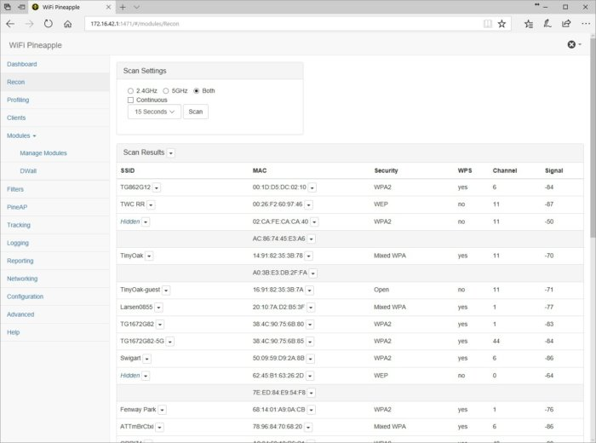

Slide 18
Steps
Design
Configure
Instrument
Monitor
Maintain and Enhance

Slide 19

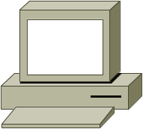




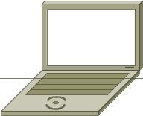
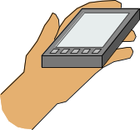
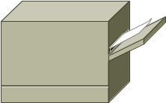

Slide 20
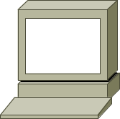
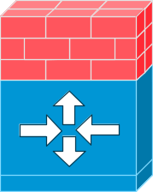





Read-Only Tap
IDS
DMZ
Protected
Zone
Wireless

Slide 21
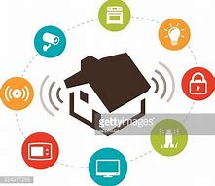
Read-Only Tap
IDS/IPS
DMZ
Protected
Zone
Wireless

Slide 22
cryptography
1-2-3-4
Steganography
Hash
Symmetric
Asymmetric

Slide 23
cryptography
1-2-3-4
Algorithm
Key
Plain text
Cypher text

Slide 24
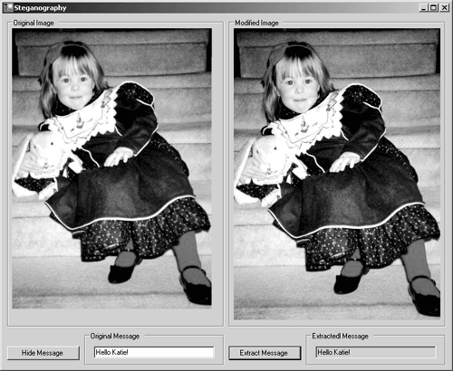
Steganography

Slide 25
hash
One way
Fixed length output
Any length input
Message digests
E.g. MD2,MD4,MD5,SHA-1,SHA-2
Used for integrity, digital signing & passphrases

Slide 26
symmetric
Plain text, algorithm, key, cypher text
Algorithm usually public
Key space is important
Reversible with the one key
Does not scale
E.g. RC4,SEAL DES,3DES,RC5,Rijndael
One-time pad
Cryptanalysis
Control

Slide 27
CIA
Confidentiality
Integrity
Authentication
Non-Repudiation

Slide 28
Asymmetric
Public & private key
Intractable problem
Symmetric key exchange in presence of advisory
Thousands of times slower
E.g. RSA, El Gamal, ECC
Public key distributed and verified via Digital Certificate
Signing via digital signature

Slide 29
Uses of cryptography
Code signing
VPN
Confidentiality
Integrity
Authentication
Non-Repudiation
Disk and file encryption
IPSec
PKI
blockchain

Slide 30
Digital Certificates
Part of PKI
Binding of public key to entity
Verified and signed by certificate authority
Chain of trust Built in
Self signed abuse
CA abuse
WEB proxies

Slide 31
Wi-Fi
Radio
Alliance
ad-hoc
2.4GHz
5GHz
RF power
Channels
Interference yours theirs
a/b/g/n/ac

Slide 32
Wi-Fi
Security
WEP
WPA
WPA2
WPA3
Shared key PSK Enterprise
Wi-Fi Protected Setup (WPS)
Data capture only data is encrypted
Disassociate attacks
Spoofing
Replay

Slide 33
Network Tap
Privacy, IDS, IPS, network flow
DMZ server
Filtering WEB proxy, split DNS, honeypot
Evidence
Prevention - good
Detection - vital

Slide 34
Configure
Hardware and software firewalls
Filter BOTH ways Default Deny
Operating system options
Linux, BSD, Tails
Segmentation is key

Slide 35
Instrument
Logging to maximum
Central logging server in protected zone
Host based IDS tripwire, regmon
Defense in depth
SNMP off or secured

Slide 36
Monitor
Filter logs discard benign
Check Configurations often
Inventory and Update
ShieldsUp!
www.grc.com
GRC’s UPnP Exposure Test
Shodan

Slide 37
Virtual
VLan
Virtual Local Area Network
VPN
Virtual Private Network
Virtual Machine
SDN
Software Defined Network

Slide 38
Got old?
Inventory Network Map
Got old?
Use device (NonCellular)as IoT controller
Hard wired
Segmentation
Tape on appropriate cameras
Turn down gain on microphones
use sound muffling material on mic covers
Home assistants, computer audio, ultra frequency communications

Slide 39
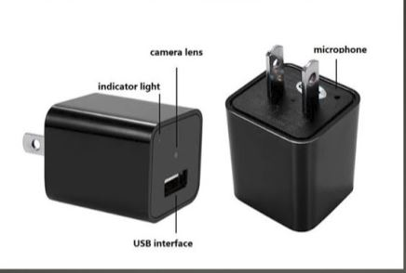
USB

Slide 40
USB
Use charging HUB for guest, not a computer
USB condom
Rubber Duckie
Flame thrower
Disable autorun
SCAN with security suites on virtual machine - sandbox Linux Live CD

Slide 41
Cutting the cord
Cable delivers all channels
Streaming services, require selection at service and credit card or financial info
Opt-in man include ad delivery to nearby devices

Slide 42
Smart getting smarter
Smart TV
Smart utility meters
Smart homes
Smart abuse
ALL the protections will NOT prevent the ONE lure
Chicken little

Slide 43
SCCCCyber@gmail.com
Tortoise and Hare
Chicken Little
Computer Club, Help Center, SIGs, Presentations
Cyber Security SIG meetings, NEWSBLOG
Internet
Questions, suggestions, comments?

